Slide 1
Agenda for GEOG260/360 GIS & Land Change Models
November 8
Distribute sheets for exam notes. Show Blue Books.
Review trajectories
Ideas for projects
Chapters 2-3 of Bilintoh’s dissertation use the LTER data. Chapter 4 uses the NASA data. See on Canvas TBilintoh_Doctoral_Thesis_v1.pdf
To prepare for the exam, see the past exams on Canvas and read the following, which are on Canvas
Exam 2022 Answer Key for Multiple Choice Questions
Exam 2020
2019 exam to serve as a study guide for this year's exam
Zhang et al. - 2023 - A user-friendly assessment of six commonly used ur.pdf
Viana et al. - 2023 - Four Fundamental Questions to Evaluate Land Change.pdf
Brown et al. (2013) Opportunities to improve impact, integration, and evaluation of land change models
Pontius et al. (2018) Lessons and Challenges in Land Change Modeling Derived from Synthesis of Cross-Case Comparisons
Comparison of Three Maps at Multiple Resolutions: A Case Study of Land Change Simulation in Cho Don District, Vietnam
November 13
Feedback on Proposals
Exam Preparation & Readings
November 15 Deadline for abstracts submitted to https://www.aag.org/events/aag2024/
Exam Preparation & Readings
November 20
In Class Exam
November 27 to December 11, which is the last day to withdraw from the course
Project Presentations
December 18 during Final Exam time slot 6:30-8:30pm
Make-up project presentation time slot in case a project presentation must be postponed
December 13
Project PPTX file due
December 20
Project Product due

Slide 2
Latitude (ten thousand meters)
Longitude (ten thousand meters)

Slide 5
How to use Bilintoh’s R package
Download the trajectory R package from the GitHub repository at https://github.com/bilintoh/timeseriesTrajectories.
Users must run the following codes in R to install the package:
install.packages("devtools")
library(devtools)
install_github("bilintoh/timeseriesTrajectories")
Thomas Bilintoh | Ph.D. Candidate
Graduate School of Geography | Clark University
Email: tbilintoh@clarku.edu
Portfolio: https://tbilintoh.weebly.com/

Slide 6
Additional Idea for projects
Make a video linked to a Wikipedia site for Kappa the Undead using and designing graphics that Pontius is making with Marco Millones and Tom Francis concerning 200 citations. The analysis reports the citations by the recommendations followed, journal, publisher, country of first author, and number of citations. See these publications, which are at the bottom of the list of publications on our Canvas site:
Stutz et al. 2023 Ch(e)atGPT? An Anecdotal Approach Addressing the Impact of ChatGPT on Teaching and Learning GIScience
Kirchherr 2023 Bullshit in the Sustainability and Transitions Literature: a Provocation
See the Death to Kappa video at https://www2.clarku.edu/faculty/rpontius/videos.html

Slide 7
A cascade of social forces generate bad science.
Promotion criteria include number of publications.
Authors think that they must claim high accuracy and include many citations of famous authors in order for a paper to be accepted. The authors are not wrong because of point 3.
Reviewers give superficial reviews because of negligible reward for reviewing. Some reviewers think that a good paper claims high accuracy and has many citations.
Journals get their status by having high impact factor, so journals facilitate citations of their journals regardless of whether the authors purchase or read the article.
Some authors do not read the papers that the cite.
Authors use metrics such as kappa for social reasons, not scientific reasons.

Slide 8
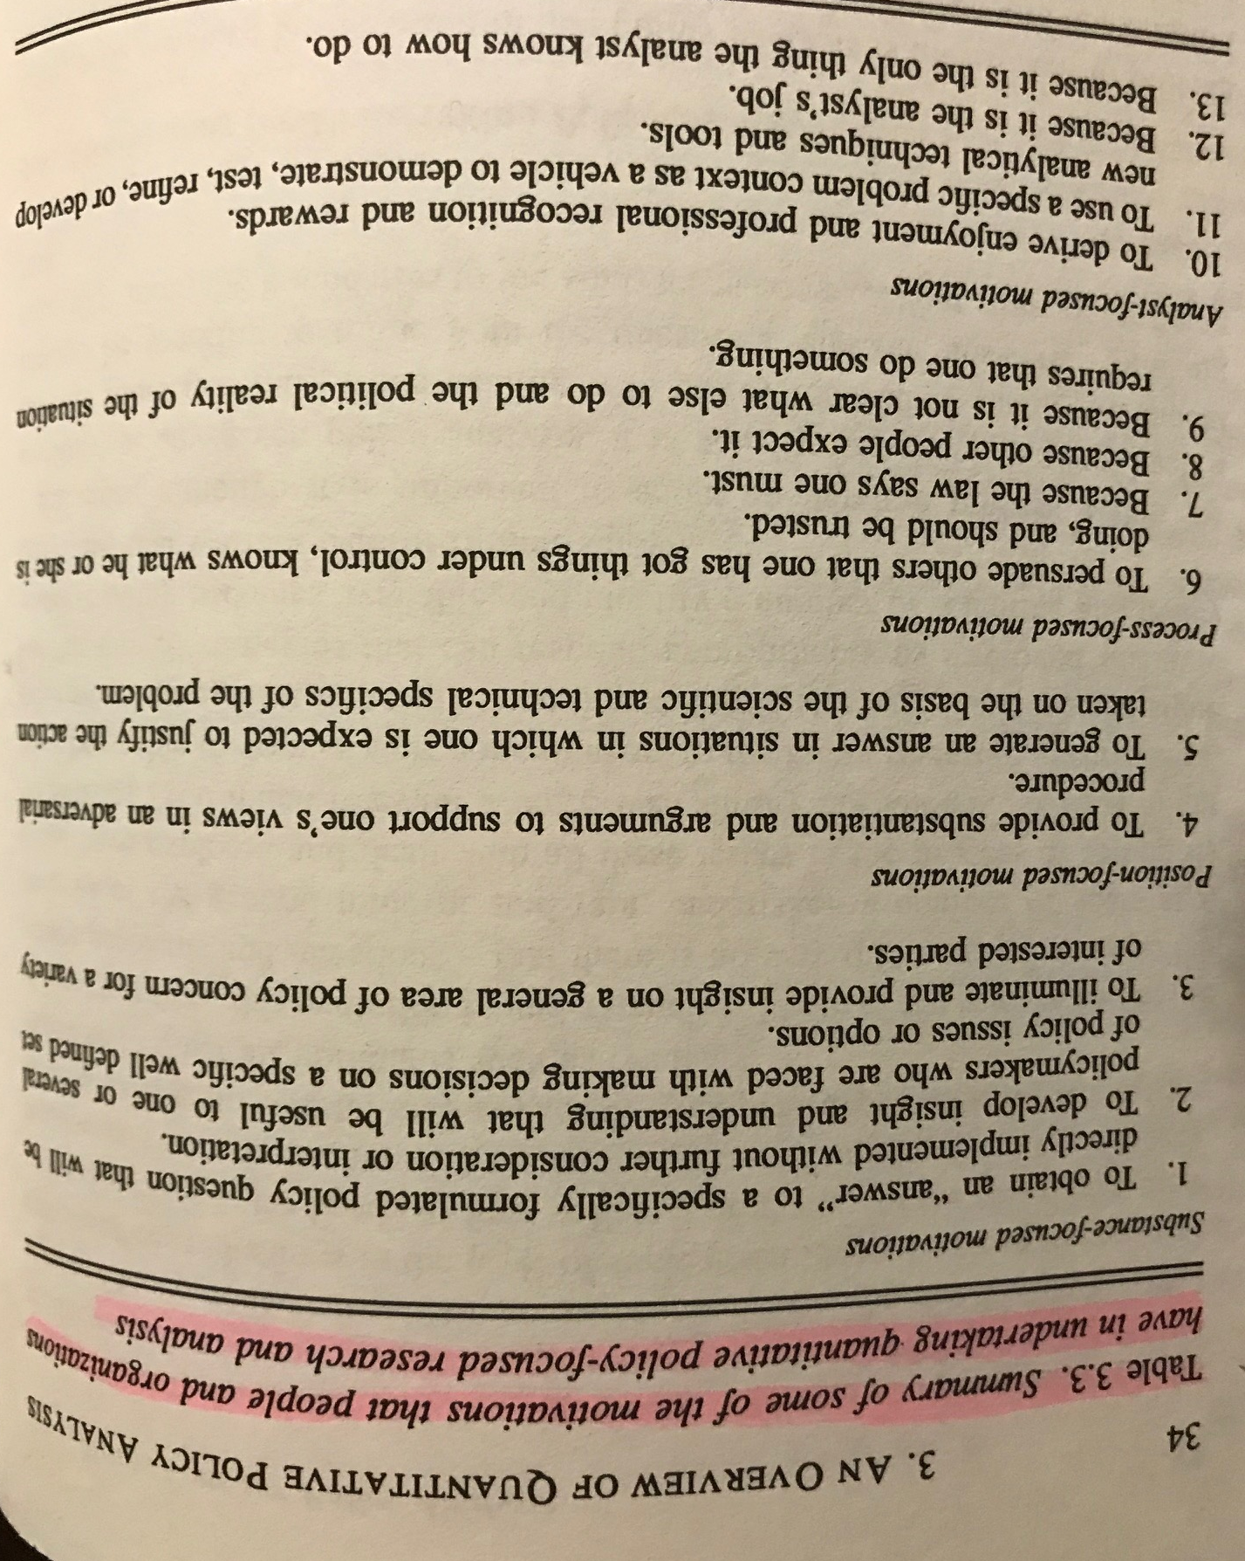
Many of us became scientists because we had Substance-focused motivations. Some literature indicates that many authors have Analyst-focused motivations. Morgan and Henrion (1990) UNCERTAINTY: A Guide to Dealing with Uncertainty in Quantitative Risk and Policy Analysis. Cambridge University Press.

Slide 9
This Morning’s Message to Pontius from a hub in China
Dear Professor,
Hope this mail finds you really healthy!
Sorry for my interruption! I have seen your research topics in the Frontiers/MDPI series of journals, and I am very interested in these research topics. I am taking the liberty to say that I would like to publish my paper more easily. I need your help during the review process, and I will provide you with research funding or quote a large number of your articles to express my gratitude! My colleagues and I have many papers to publish every year, and I can establish a long-term cooperative relationship with you.
Thank you for your attention, I look forward to your reply!
Yours,
John.Hanns

Slide 10
Pontius’ Response to John in China
Dear John,
I am no longer interested in being involved in the low quality work that MDPI and Frontiers regularly publish with their shoddy and flawed review process that is designed to generate revenue for the publishers in a system that floods the literature with useless and flawed papers. I have no interest in publishing articles merely for the professional promotion of the authors based on flawed criteria such as number of citations.
I recommend you spend your time doing serious research that helps to advance science, rather than to advance your career and the careers of the collaborators that you seek merely for their prestige and ideas. I recommend you read my papers to inspire you to create your own ideas. You can begin with the papers listed at www.clarku.edu/~rpontius and the videos at https://www2.clarku.edu/faculty/rpontius/videos.html
R G Pontius Jr

Slide 11
What do you think of the title of this popular statement?
Our measurement of model validation is high, therefore we can use the model to generate scenarios.

Slide 12
What do you think of the title of this popular statement?
Our measurement of model validation is high, therefore we can use the model to generate scenarios.
Validation concerns prediction. Scenarios are not predictions. Validation is irrelevant to Scenarios. Many scenarios intentionally portray storylines that deviate from data concerning recent trends.
The use of the word “can” is sloppy. You can use a model means you have the ability to use it, which requires a computer and code that produces output but not validation.
Many authors think that they must claim that the model is valid to publish a paper, which they know is essential for their career advancement. Thus authors use bogus methods to claim the model is valid. Career advancement of the authors seems to be the main purpose of most journal articles that Research Gate sends to Pontius. Ironically, scenarios do not require validation, but authors fear that reviewers ask for validation.

Slide 13
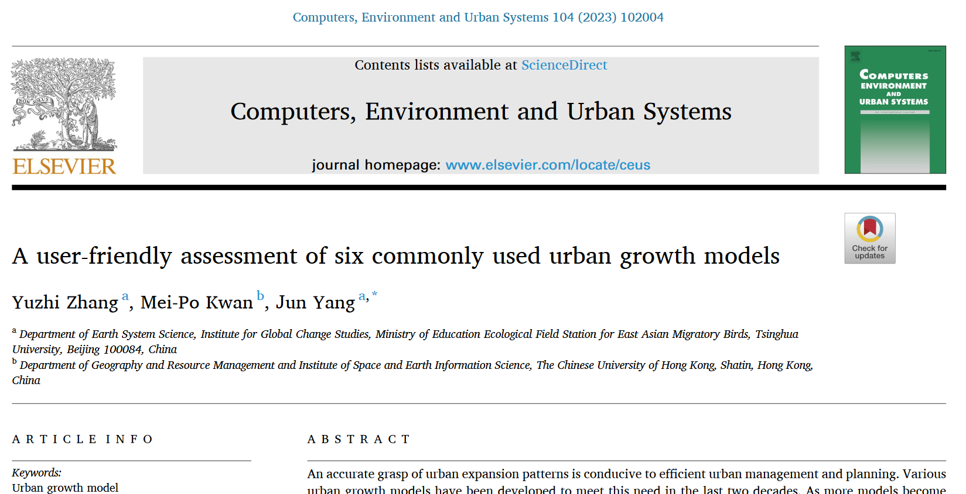
This is a helpful manuscript, which is on Canvas.

Slide 14
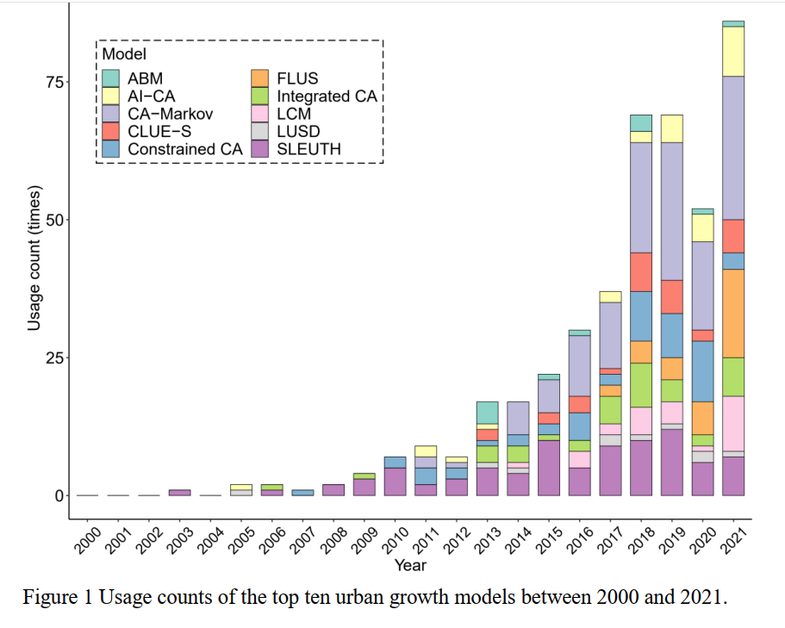

Urban growth modeling is increasing in the literature. CA-Markov and LCM in TerrSet are influential.

Slide 15
What advice do you have for authors who compared urban growth models initially by these steps?
Authors compared six urban growth models to advise others which models to use. The authors analyzed a city where the calibration interval was 2002-2015 and validation interval was 2015-2020. The authors never state the size of urban growth during the calibration interval or validation interval.
Three of the models use the Markov matrix to extrapolate the quantity from the calibration interval to the validation interval.
Those three models varied in their simulated quantities, specifically simulating 84, 137, and 177 square kilometers of urban gain.
The authors used validation to show that the models had errors that were from 6 to 14 times larger than hits.
The authors conclude that others should use their methodology for more case studies.
My thoughts- Although the 3 models used Martkov’ there will ceratianly be a difference, each algorithm behaves differently. Thus they should rather evaluate the models based on whether the model is doing what its documentation states its should thus isit verifiable. In which case is not because Markov shows a sharp gain, and slows down in gain with a horizontal. But that is not the case.
Also the models should be assessed based on when the authors understand , can control it and their audience understand the models used. Finally the

